Slide 1
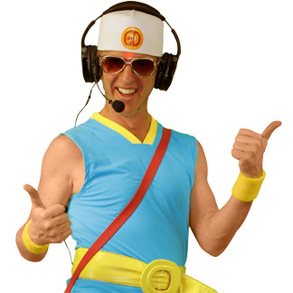
Dance Guru
-Making a Teachers Profession much easy.

Slide 2
IDEA !
What if a teacher can record his or her dance moves on to students phone and those same moves can be performed by the student in the absence of the teacher and still gets to know whether the step was done correct or not.

Slide 3
Concept !
Recorded
Teacher Moves
Dance
Moves
Comparison
Right
Wrong
Result

Slide 4
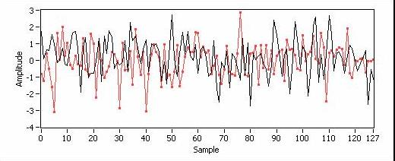
Comparison !
Cross Correlation

Slide 5
Result !
The student can learn dance steps without the presence of teacher and the app scores the dance steps accordingly.
The teacher now can concentrate on more students at once and he/she can also use this opportunity to take free time from her/his tight schedules…

Slide 6
Tackles !
Teachers try to dismiss classes early dude to which students do not get enough time of dance practice in the presence of the teacher.

Slide 7
Applications !
The app is not only for students, the app can be used by professional dances to improve their moves. The moves are compared with their best moves and get a score accordingly.

Slide 8
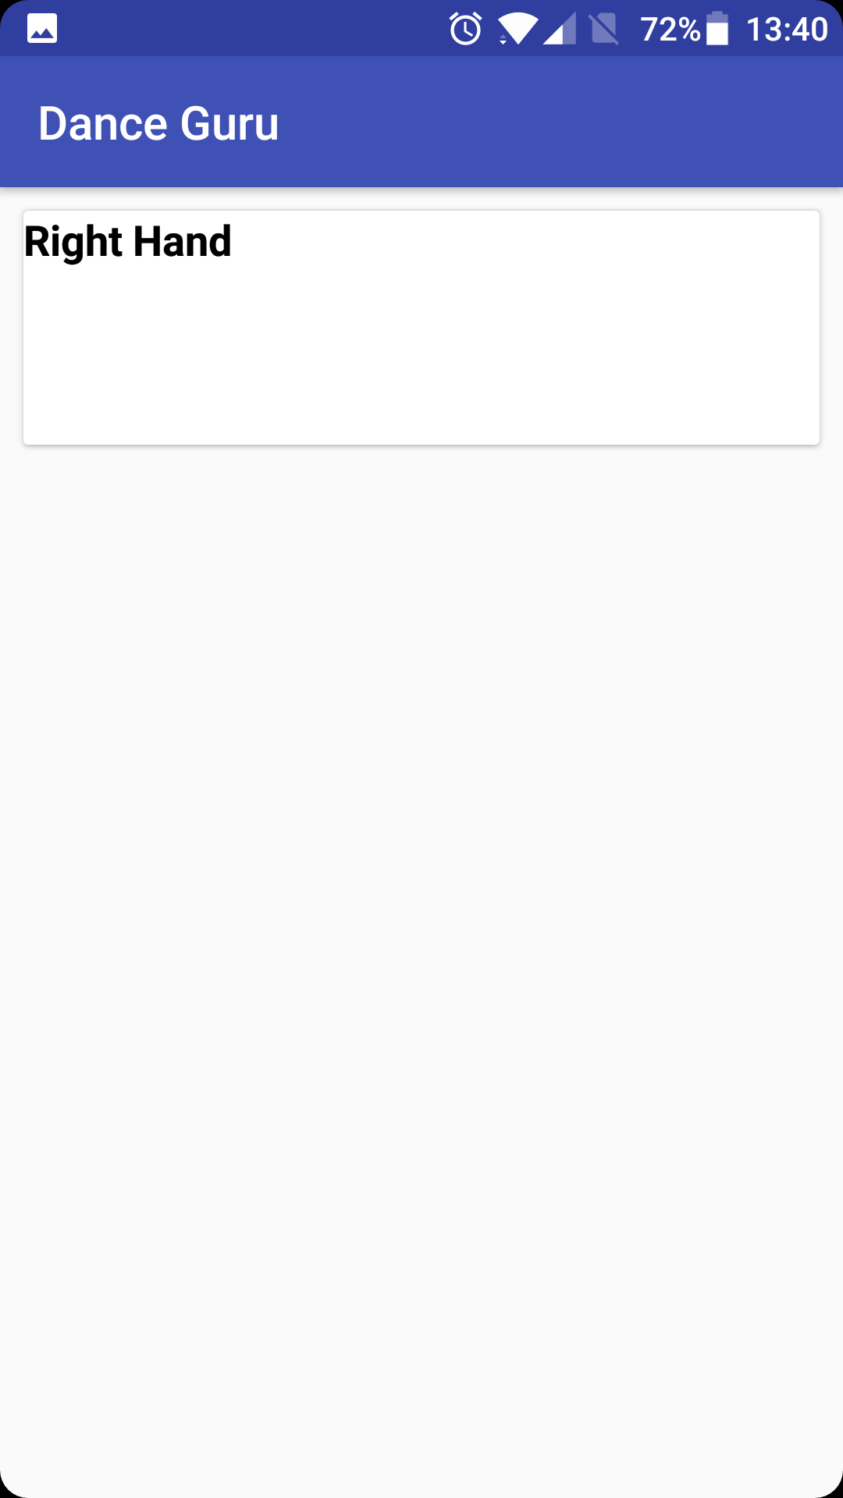
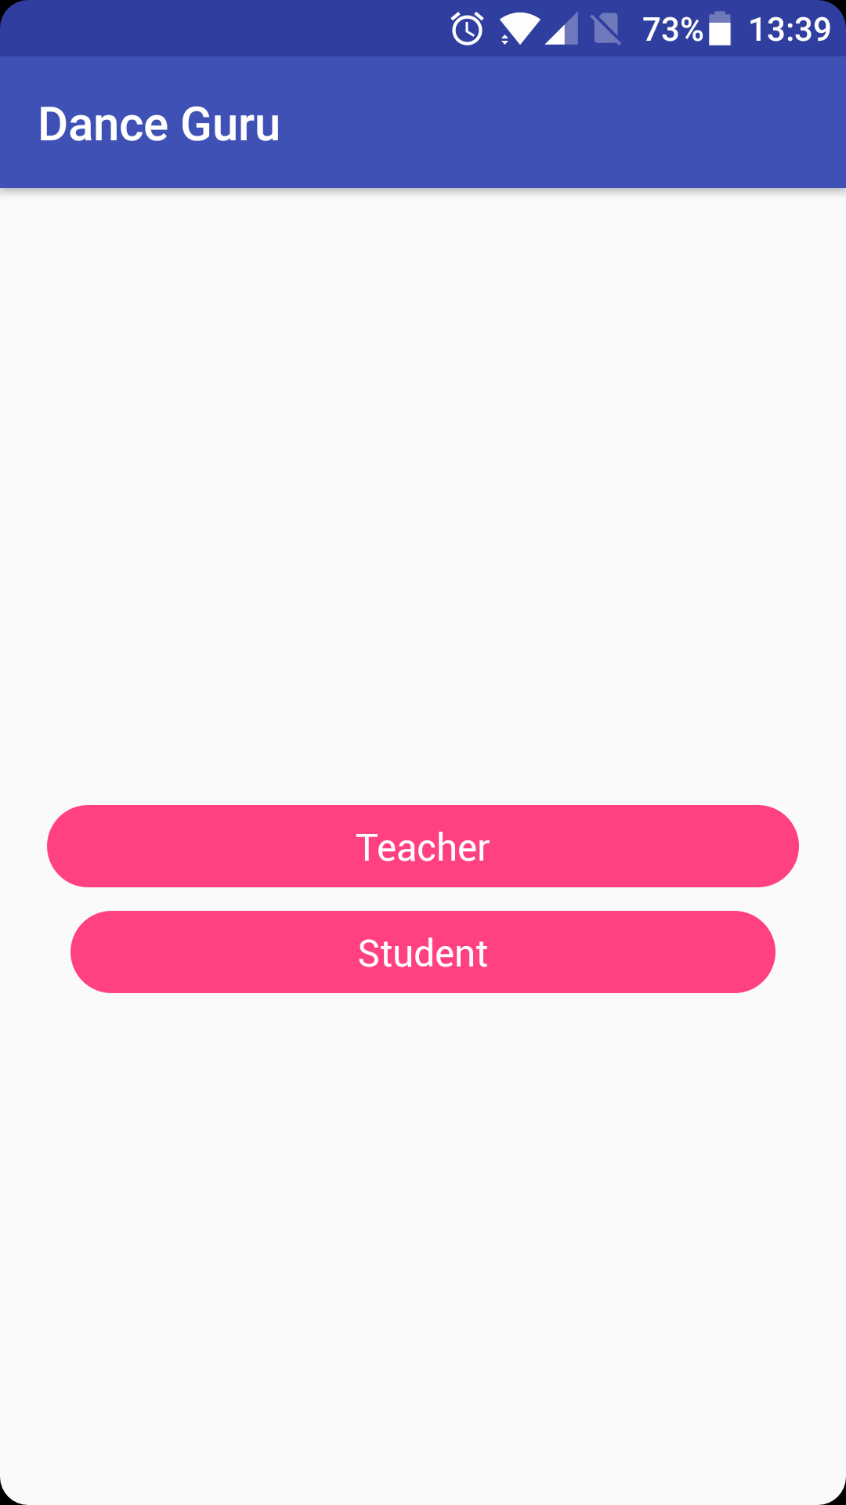
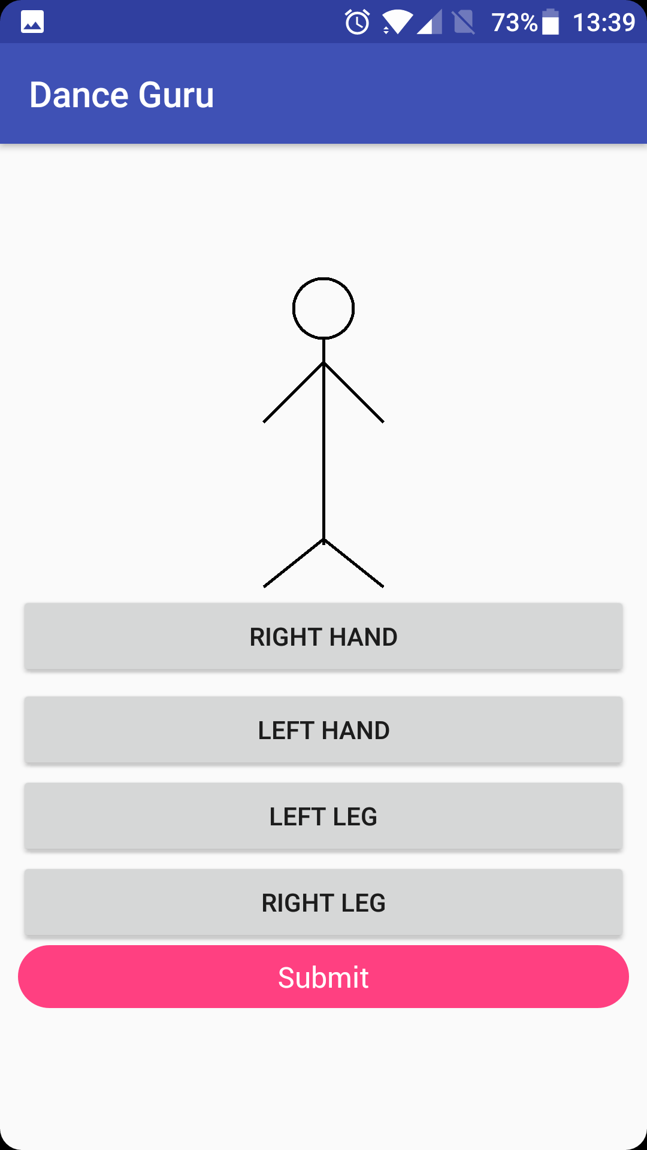

Slide 9
DEMO

